Slide 1
Shri Chhatrapati Shivaji College, Omerga
Dept. of Physics and Electronics
Subject: Physics Paper No. XV
Class: B. Sc. VI Semester
Quantum Mechanics
Dr. A. S. Padampalle

Slide 2
Need for Quantum Physics
Problems remained from classical mechanics that the special theory of relativity didn’t explain. Attempts to apply the laws of classical physics to explain the behavior of matter on the atomic scale were consistently unsuccessful.
Problems included:
Blackbody radiation
The electromagnetic radiation emitted by a heated object
Photoelectric effect
Emission of electrons by an illuminated metal
Quantum Mechanics Revolution
Between 1900 and 1930, another revolution took place in physics.
A new theory called quantum mechanics was successful in explaining the behavior of particles of microscopic size.
The first explanation using quantum theory was introduced by Max Planck.
Many other physicists were involved in other subsequent developments

Slide 3
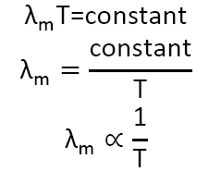
Black body:
A perfect black body is one which absorbs all the radiation of heat falling on it and emits all the radiation when heated in an isothermal enclosure.
The heat radiation emitted by the black body is called black body radiation.
Laws of Black body radiation:
1) Wien’s displacement law:
This law states that the product of the maximum wavelength (λ_{m}) corresponding to the maximum energy and the absolute temperature is a constant.
i.e. when the temperature increases the wavelength corresponding to the maximum energy decreases.

Slide 4
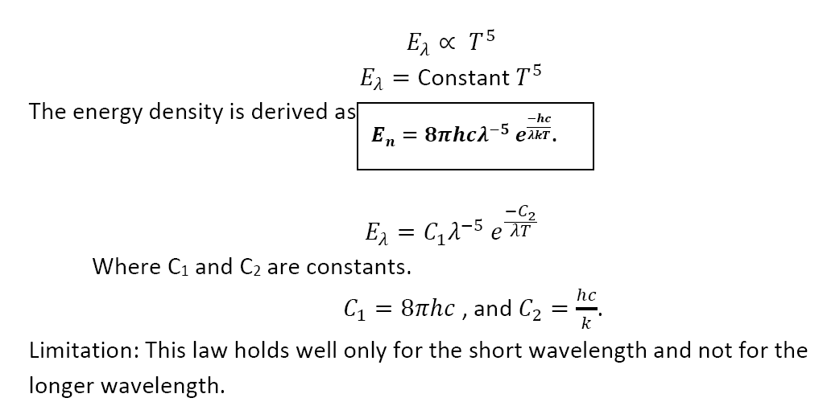
Wien’s radiation law:
The maximum energy radiated at peak wavelength is directly proportional to the fifth power of the absolute temperature (T⁵).

Slide 5
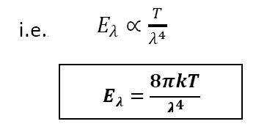
Raleigh – Jean’s Law:
This law states that the energy distribution is directly proportional to absolute temperature (T) and inversely proportional to the fourth power of wavelength (λ⁴).
Limitation: This law holds well only for the longer wavelength and not for the shorter wavelength.

Slide 6
Planck’s quantum theory of black body radiation:
Planck’s theory:
A black body contains a large number of oscillating particles:
Each particle is vibrating with a characteristic frequency.
The frequency of radiation emitted by the oscillator is the same as the oscillator frequency.
The oscillator can absorb energy in multiples of small unit called quantum.
This quantum of radiation is called photon.
The energy of a photon is directly proportional to the frequency of radiation emitted. E∝ν or E=hν
An oscillator vibrating with frequency can only emit energy in integral multiples of hν . 𝐸_{n}= nhν , where n= 1, 2, 3, 4…….n. n is called quantum number.

Slide 7
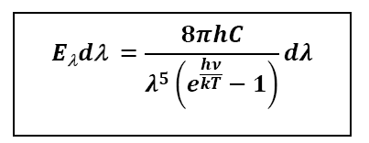
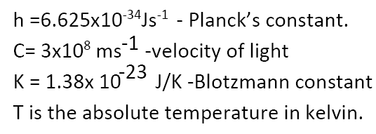
Planck’ law of radiation:
The energy density of radiations emitted by a black body at a temperature T in the wavelength range λ to λ+dλ is given by

Slide 8
Derivation of Planck’s law:
Consider a black body with a large number of atomic oscillators.
Average energy per oscillator is
Ē = E/N−−−−−(1)
Where E is the total energy of all the oscillators and N is the number of oscillators.
Let the number of oscillators in ground state is be N₀.
According to Maxwell’s law of distribution, the number of oscillators having an energy value E_{N} is given by
Where T is the absolute temperature. K is the Boltzmann constant.
Let N₀ be the number of oscillators having energy E₀,
N₁ be the number of oscillators having energy E₁,
N₂ be the number of oscillators having energy E₂ and so on.

Slide 9
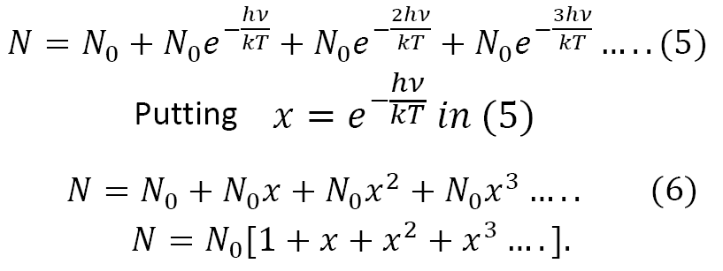
Then
From Planck’s theory, E can take only integral values of hν.
Hence the possible energy are 0, hν, 2 hν,3 hν ……. and so on.

Slide 10
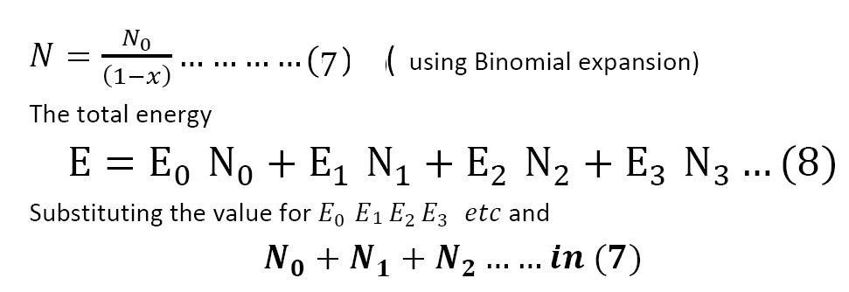
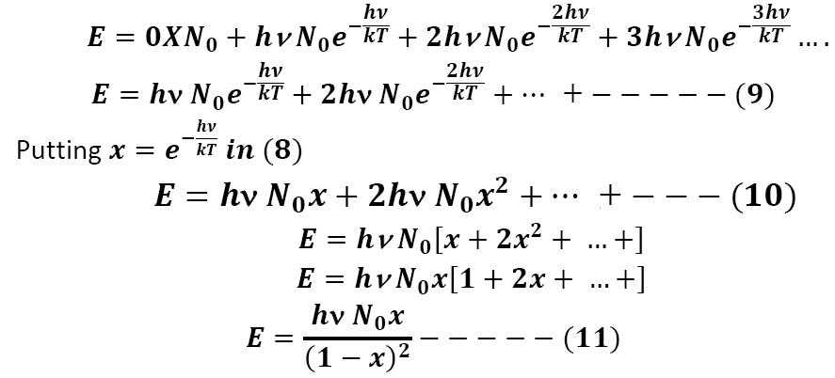

Slide 11
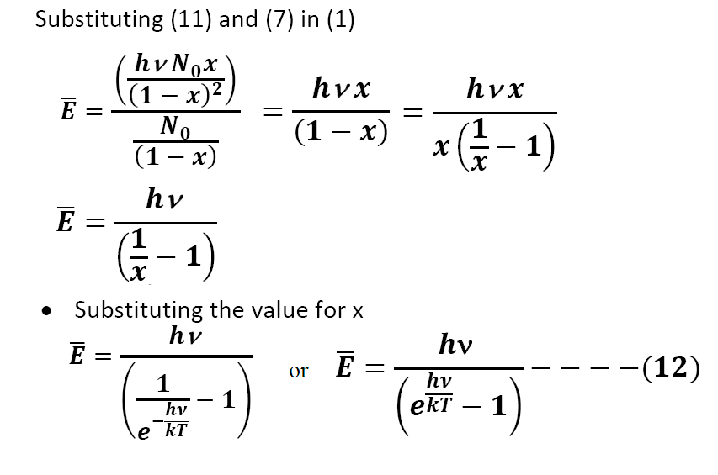

Slide 12
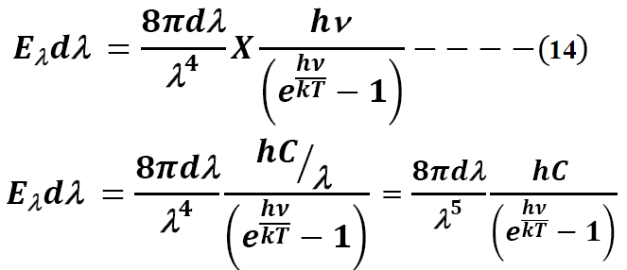
The number of oscillators per unit volume in the wavelength range λ and λ +d λ is given by
Hence the energy density of radiation between the wavelength range λ and λ +d λ is E_{λ} dλ = No. of oscillator per unit volume in the range λ and λ +d λ X Average energy.

Slide 13
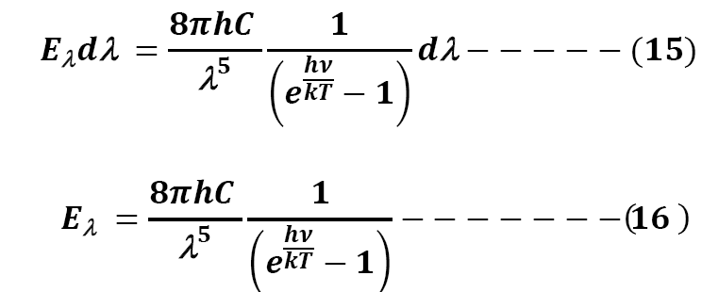
The equation (16) represents Planck’s law of radiation.
Planck’s law can also be represented in terms of frequencies.

Slide 14
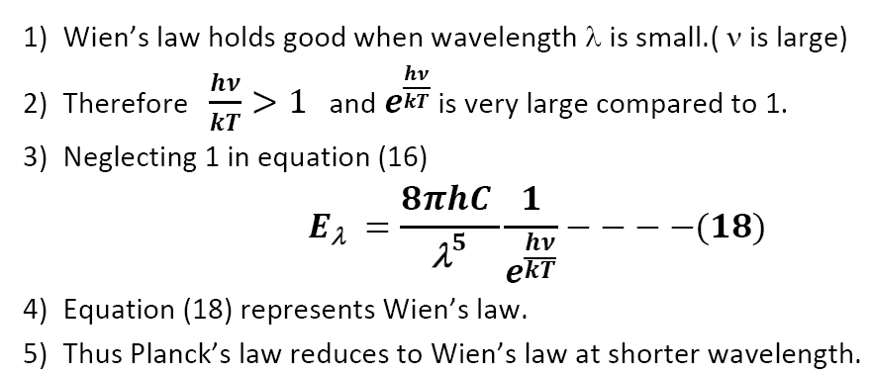
Deductions of Radiation laws from Planck’s Law:
Wien’s Law:

Slide 15
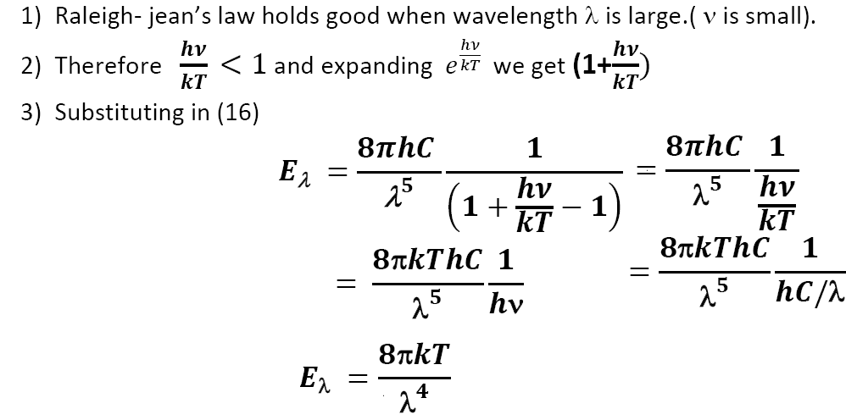
II. Raleigh- Jean’s law:
Thus Planck’s law reduces to Raleigh- jean’s law at longer wavelength.

Slide 16
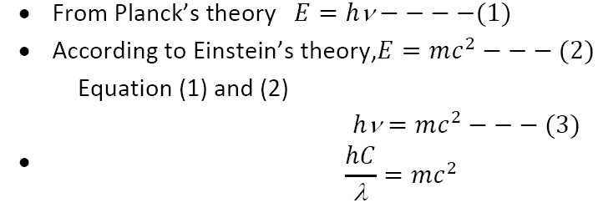
Matter Waves
De Broglie’s Hypothesis:
1. Waves and particles are the modes of energy propagation.
2. Universe of composed of matter and radiations.
3. Since matter loves symmetry matter and waves must be symmetric.
4. If radiation like light which is a wave can act like particle some time, then materials like particles can also act like wave some time.
De Broglie waves and wavelength:

Slide 17
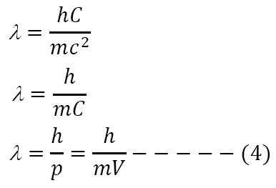
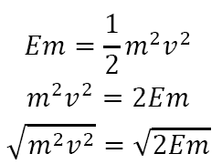
Therefore,
Where p = mv is the momentum of the particle of mass m and velocity V.
De Broglie wavelength in terms of energy
We know that Kinetic energy
Multiplying by m on both sides

Slide 18
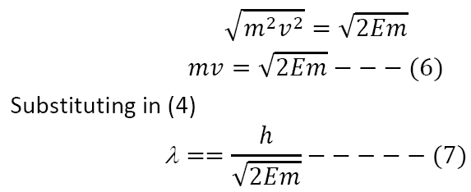
Eq^{n} (7) represent De Broglie’s wavelength in terms of energy.
Let q be charge and V be potential on charged particle then, Kinetic energy of particle is E = qV .
De Broglie wavelength is

Slide 19
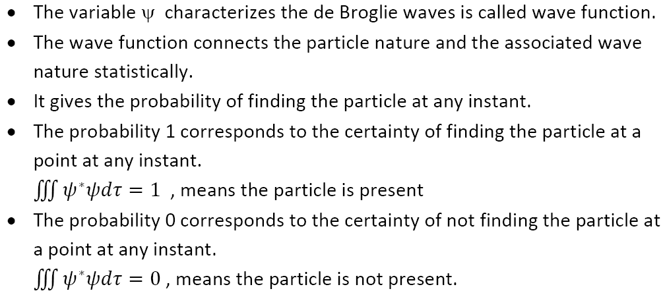
Physical significance of the wave function ψ

Slide 20
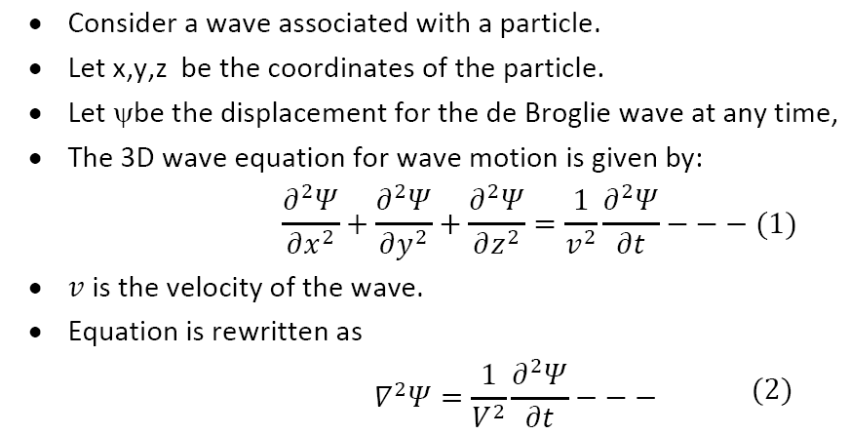
Schrodinger wave equation
Schrodinger equation is basic equation of matter waves.
The two forms of the wave equation are:
1. Time independent wave equation
2. Time dependent wave equation
1. Schrodinger time independent equation:

Slide 22
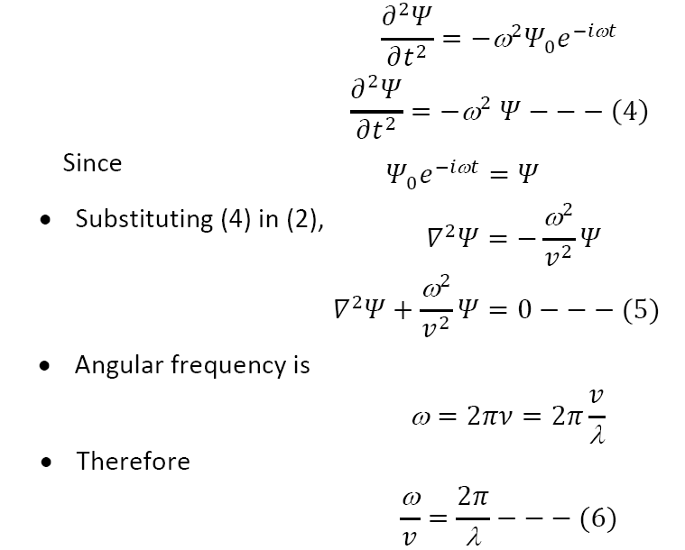

Slide 23
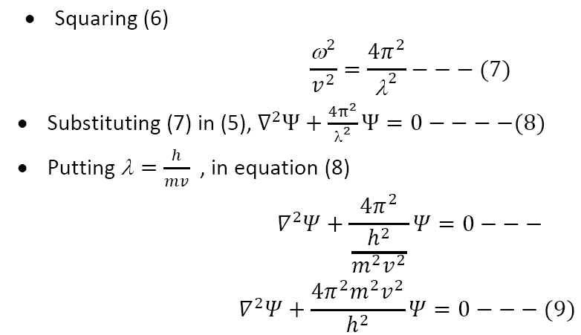
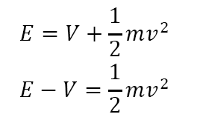
If E is the energy of the particle and V is the potential energy and ½ mv² is the kinetic energy, then Total energy (E)= potential energy (V) + kinetic energy (½ mv²).

Slide 24
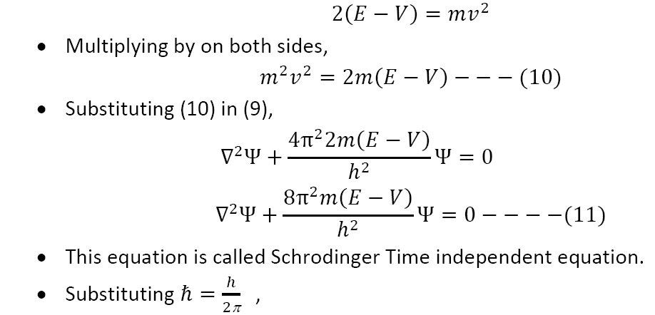

Slide 25
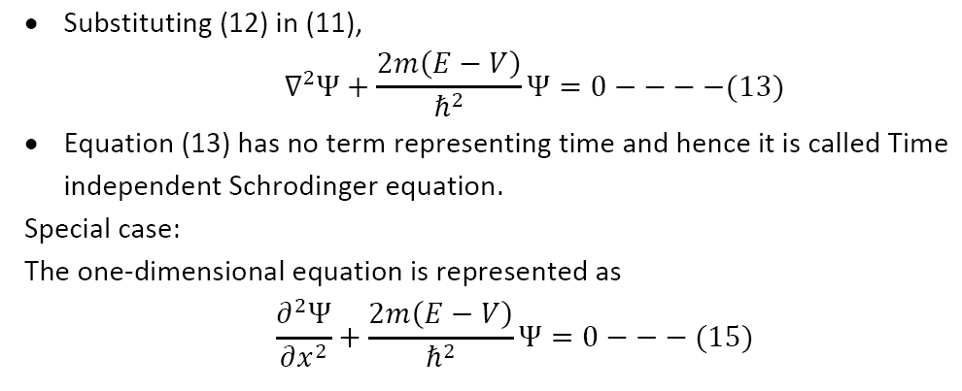

Slide 26
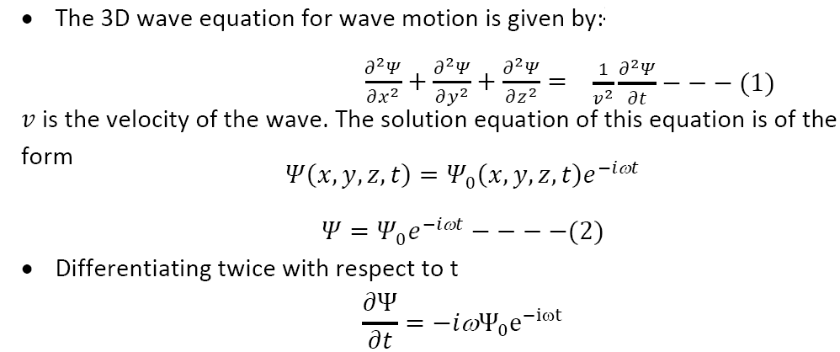
II. Schrodinger time dependent equation:
Consider a wave associated with a particle.
Let x, y, z be the coordinates of the particle.
Let ψbe the displacement for the de Broglie wave at any time,

Slide 27
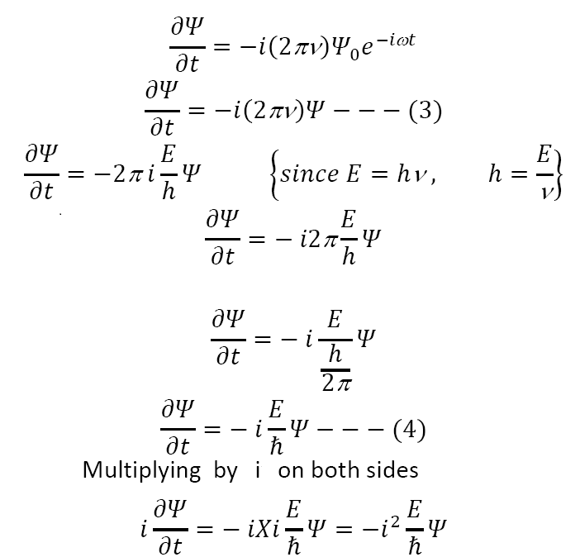

Slide 28
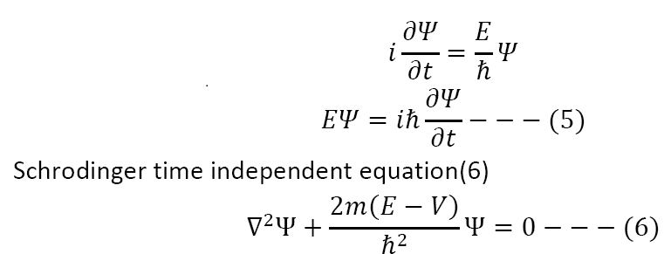
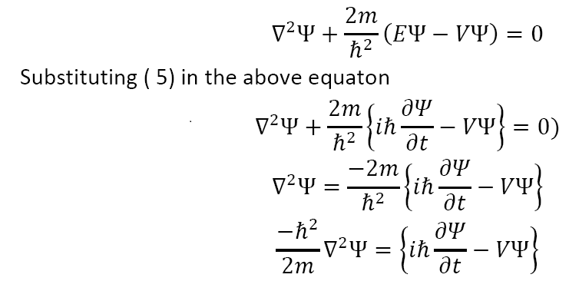

Slide 29
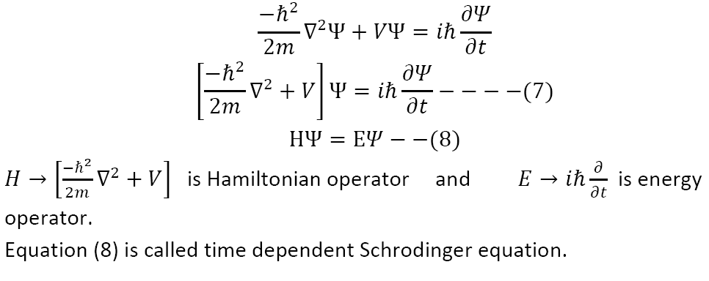

Slide 30
Thank You !

